Slide 1


SMART INDIA HACKATHON 2024
TITLE PAGE
Problem Statement ID - 1655
Problem Statement Title- Detecting oil spills at marine environment using Automatic Identification System (AIS) and satellite datasets
Theme- Smart Automation
PS Category- Software
Team ID- Yet to be provided
Team Name - Passengers

Slide 2
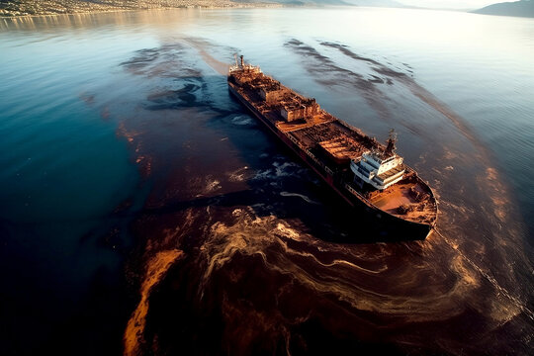
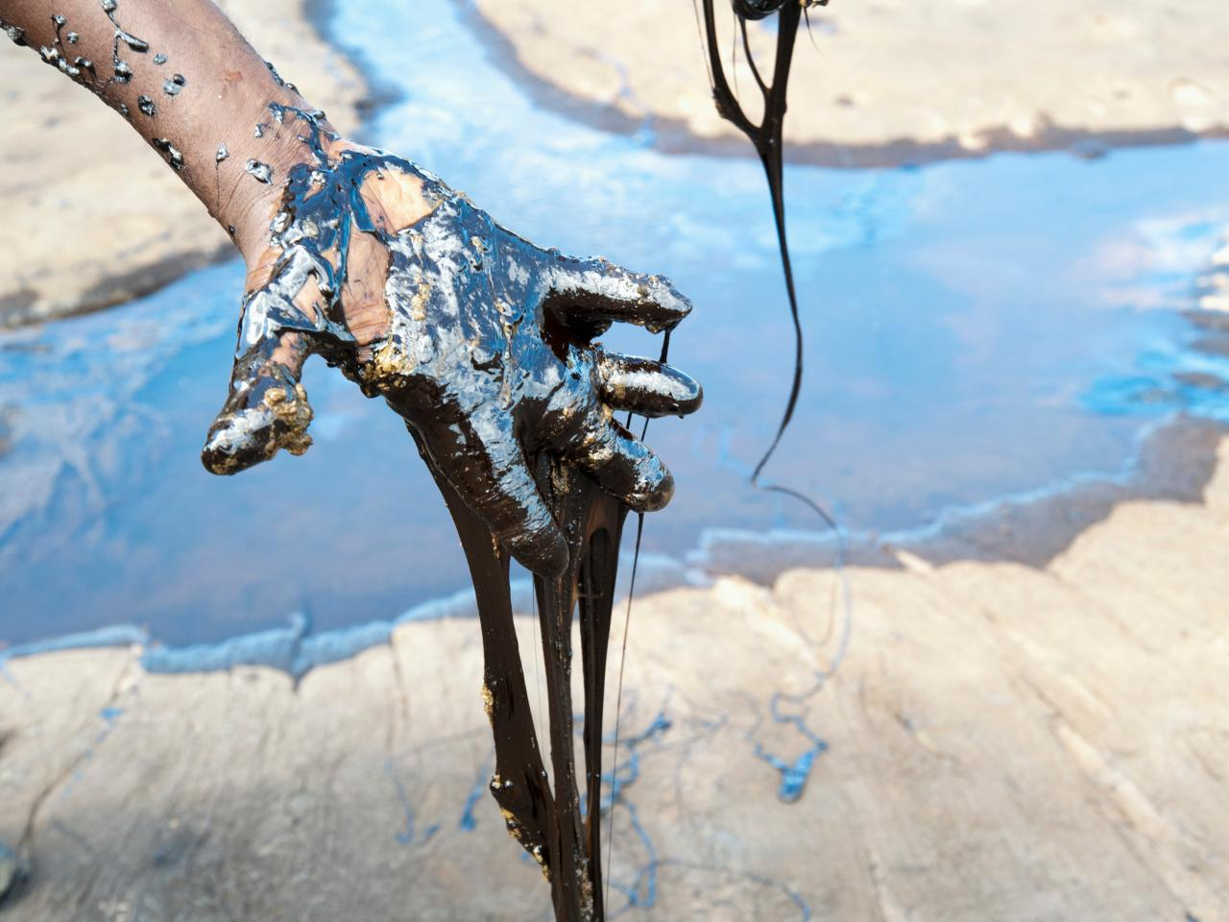
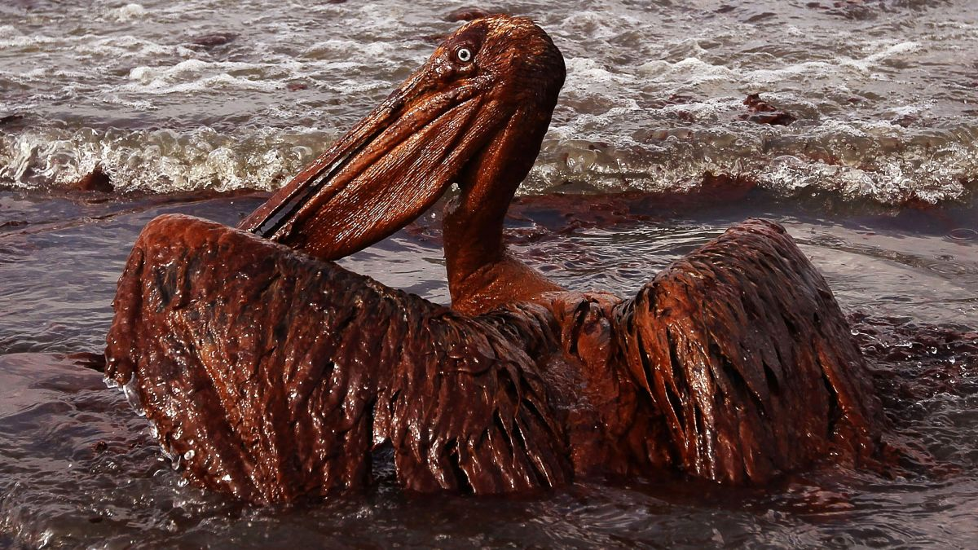
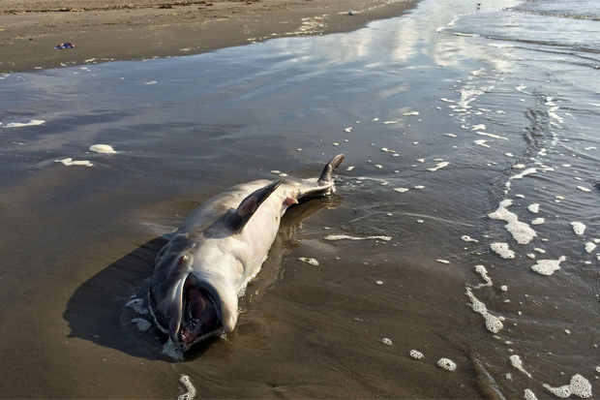
Passengers
Understanding the seriousness of the problem:
1. Marine Life: Oil spills can be devastating to marine animals, including fish, seabirds, marine mammals,
2. Coral Reefs and Seagrass: Oil can smother coral reefs and seagrass beds, leading to reduced photosynthesis, stunted growth, and eventual die-offs.
3. Water Quality: creates a toxic environment, reducing oxygen levels in the water and releasing harmful compounds like polycyclic aromatic hydrocarbons (PAHs), which can persist for years.
4.Long-Term Ecosystem Damage: Oil spills can cause long-lasting damage to ecosystems, often taking decades to recover.
If the oil spill is detected early then it will be manually cleaned at low cost by hair soaking method but if the oil spreaded then at long area then it is practically impossible to clean.

Slide 3
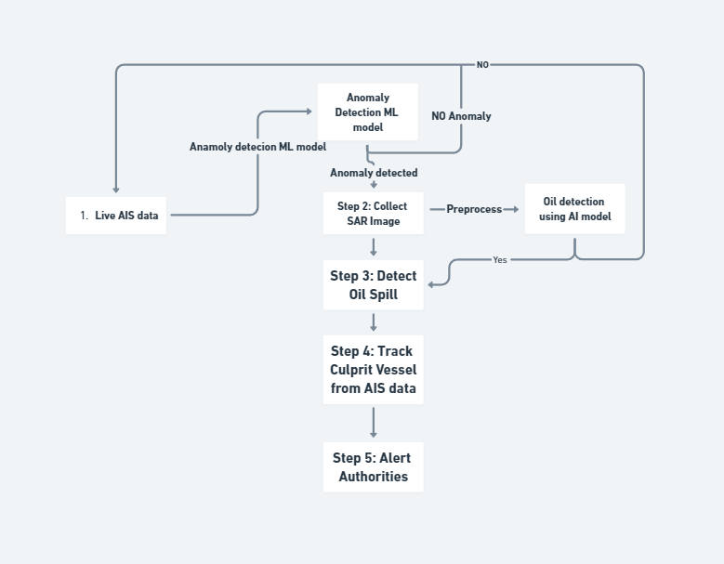
Passengers
Proposed Solution of Prototype:
Idea:
Step 1: The AIS data will be tracked continuously and passed through a anomaly detection model and check for anomaly.
Step 2: If Anomaly is detected at a certain coordinates and timestamp then the satellite SAR image is collected and preprocessed and then feed to a model which is trained to detect oil spill.
Step 3: Once the presence of the oil spill is confirmed then from the AIS data the path of the vessel is plotted
Step 4: Then the current AIS data will be used to track the live location of the culprit vessel.
Step 5: Alert authorities in case of confirmed oil spills.
To avoid any edge cases of non anomaly detection, The satellite images of the particular sea zone will be periodically passed to the oil spill detection model to ensure double safety.

Slide 4
Passengers
Basic Idea

Slide 5
Passengers
Proposed Solution of Prototype contd:
How it Addresses the Problem: Combines vessel tracking and anomaly detection through AIS with satellite-based oil spill detection such as Synthetic Apparatus radar and Multispectral satellite, enabling faster identification of spills and rapid response
Innovation: Unique integration of AIS data and satellite imagery for dual verification and early detection of oil spills. Use of machine learning to identify anomalies in vessel behavior before confirming oil leaks. Also use of RCNN and YOLO V8 to develop a very good and efficient model with a preprocessing technique that successfully identifies oil spill even in very low light and weather. Using the ground truth technique we ensure the quality of the annotation is up to the mark.

Slide 6

TECHNICAL APPROACH
Passengers
Framework of Prototype:
Programming Languages: Python (for processing AIS data, anomaly detection, satellite image analysis). JAVA for building the Android application, React for web designing.
Frameworks/Tools: 1. Google Earth Engine(For gathering data to train a machine learning model), 2. TensorFlow or PyTorch (for AI/ML models), 3. OpenCV (image processing), 4. Pandas (data handling) AIS, Scikit Learn, Folium map for vessel tracking.

Slide 7
TECHNICAL APPROACH
Passengers
Development of Prototype:
The development of the prototype will be done by the completing the following Goal.
Oil Spill image data set generation: Gathering a satellite images of oil spill in sea using Google earth engine and preprocess the images and later annotate with ground truth mask.
Model Preparation : An object detection model YOLO V8 will be fine tuned on the gathered dataset
Anomaly detection model: Logistic regression approach will be used on the AIS data to make an Anomaly detection model,
API development and Deployment: Both of the machine learning model will be deployed on the appropriate cloud server using Fastapi or flux.
Live Satellite and AIS data integration: A backend will be made to feed live satellite data and AIS datas
Post Processing the data and Interpretation: The datas and API calls will be post processed and then interpreted using a folium map which will show the live tracking and other appropriate datas
Front end and Representation: After getting the appropriate data and APIs, an web application and an android application will be developed to represent them to the device using folium app.

Slide 8
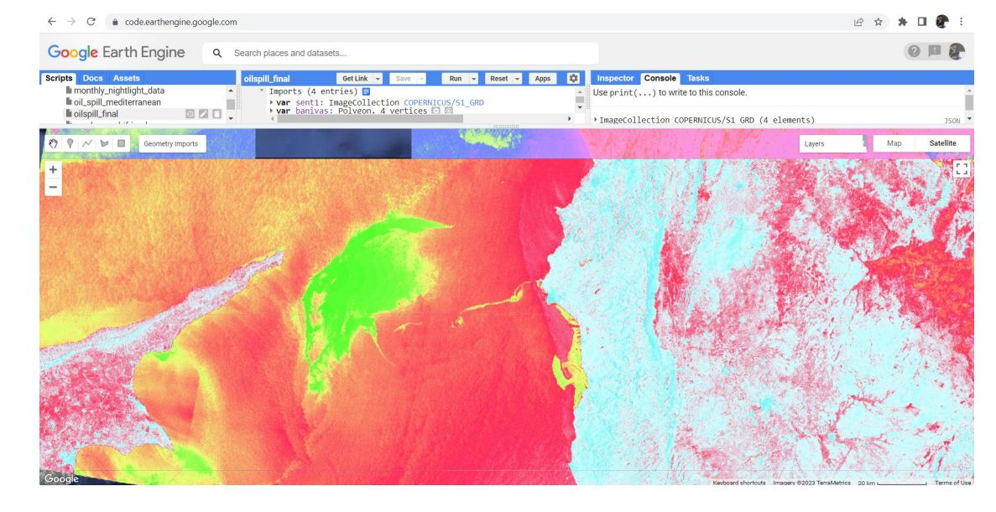
Source for Creating Dataset
Passengers
Deepwater Horizon
Date: April 20, 2010
Location: Gulf of Mexico, USA
Exxon Valdez
Date: March 24, 1989
Location: Prince William Sound, Alaska, USA
Ixtoc I Oil Spill
Date: June 3, 1979 – March 23, 1980
Location: Bay of Campeche, Gulf of Mexico, Mexico
Amoco Cadiz
Date: March 16, 1978
Location: Coast of Brittany, France
Atlantic Empress
Date: July 19, 1979
Location: Off the coast of Tobago, West Indies
MV Braer
Date: January 5, 1993
Location: Shetland Islands, Scotland
Hebei Spirit
Date: December 7, 2007
Location: Yellow Sea near Taean, South Korea
Prestige Oil Spill
Google Earth Engine

Slide 9
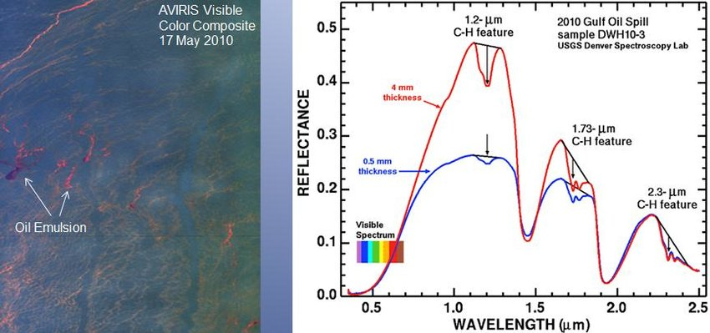
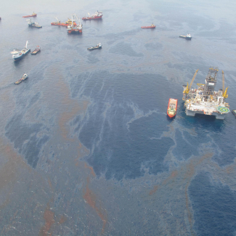
Analysis of oil spill on visible spectrum
Passengers

Slide 10
How the anomaly can be detected using AIS
Passengers
Anomaly Detection in Ships Using AIS Data
Preprocessing AIS Data: Clean and normalize data (position, speed, heading, time).Segment trajectories for detailed analysis.
Key Feature Extraction: Speed Over Ground (SOG), Course Over Ground (COG), position, heading.
Anomaly Detection Techniques:1. Rule-Based Detection: Speed limits, unusual turns, stationary periods in non-designated areas. 2. Statistical Methods: Z-Score, clustering (K-means, DBSCAN) to identify outliers. 3. Machine Learning: Unsupervised (Isolation Forests, Autoencoders) & Supervised models. 4. Time Series Analysis: Detect deviations in speed, course, and movement patterns. 5. Geospatial Analysis: Geofencing, path deviations from historical routes. 6. Behavioral Analysis Identify route anomalies, unscheduled stops, collision risks.
Visualization & Alerts :GIS tools for trajectory visualization and anomaly scoring Real-time alerts for severe anomalies.

Slide 11
FEASIBILITY AND VIABILITY
Passengers
Challenges and strategies:
Low Resolution and Noise in Satellite Imagery:
Challenge: Poor image quality and noise can hinder accurate spill detection.
Strategy: Post processing for noise reduction
Correlating Vessel Behavior with Spill Detection:
Challenge: High vessel density and varying behavior complicate correlation with spills.
Strategy: Analyzing behavioral anomalies (e.g., erratic movements).
Use temporal and spatial filters to focus on relevant vessels. Integrating additional tracking data for verification.
Accurate Spill Attribution and Drift Modeling
Challenge: Difficulties in attributing spills and modeling drift due to environmental factors.
Strategy: Utilizing drift simulation models based on environmental data. Integrating real-time sea state data.
Collaborating with marine experts to refine models.

Slide 12
IMPACT AND BENEFITS
Passengers
Impacts and Benefits of solution:
1.Environmental Protection:
Early Detection and Response: Rapid identification of oil spills allows for timely response and mitigation, minimizing the environmental damage caused by oil contamination.
Reduction in Ecosystem Damage: Prompt action helps to protect marine life, shorelines, and sensitive ecosystems from prolonged exposure to oil pollutants.
2.Regulatory Compliance:
Enforcement of Regulations: The ability to trace spills to specific vessels supports regulatory authorities in enforcing maritime pollution laws and holding responsible parties accountable.
Improved Reporting: Provides evidence for accurate reporting and documentation of environmental incidents, aiding in compliance with international conventions and agreements.

Slide 13
RESEARCH AND REFERENCES
Passengers
Key Points and Links:
https://hub.marinecadastre.gov/
https://m4d.iti.gr/oil-spill-detection-dataset/ Relevant Research:
AIS tracking systems for maritime safety and anomaly detection.
Satellite remote sensing techniques for oil spill identification.

